Slide 1
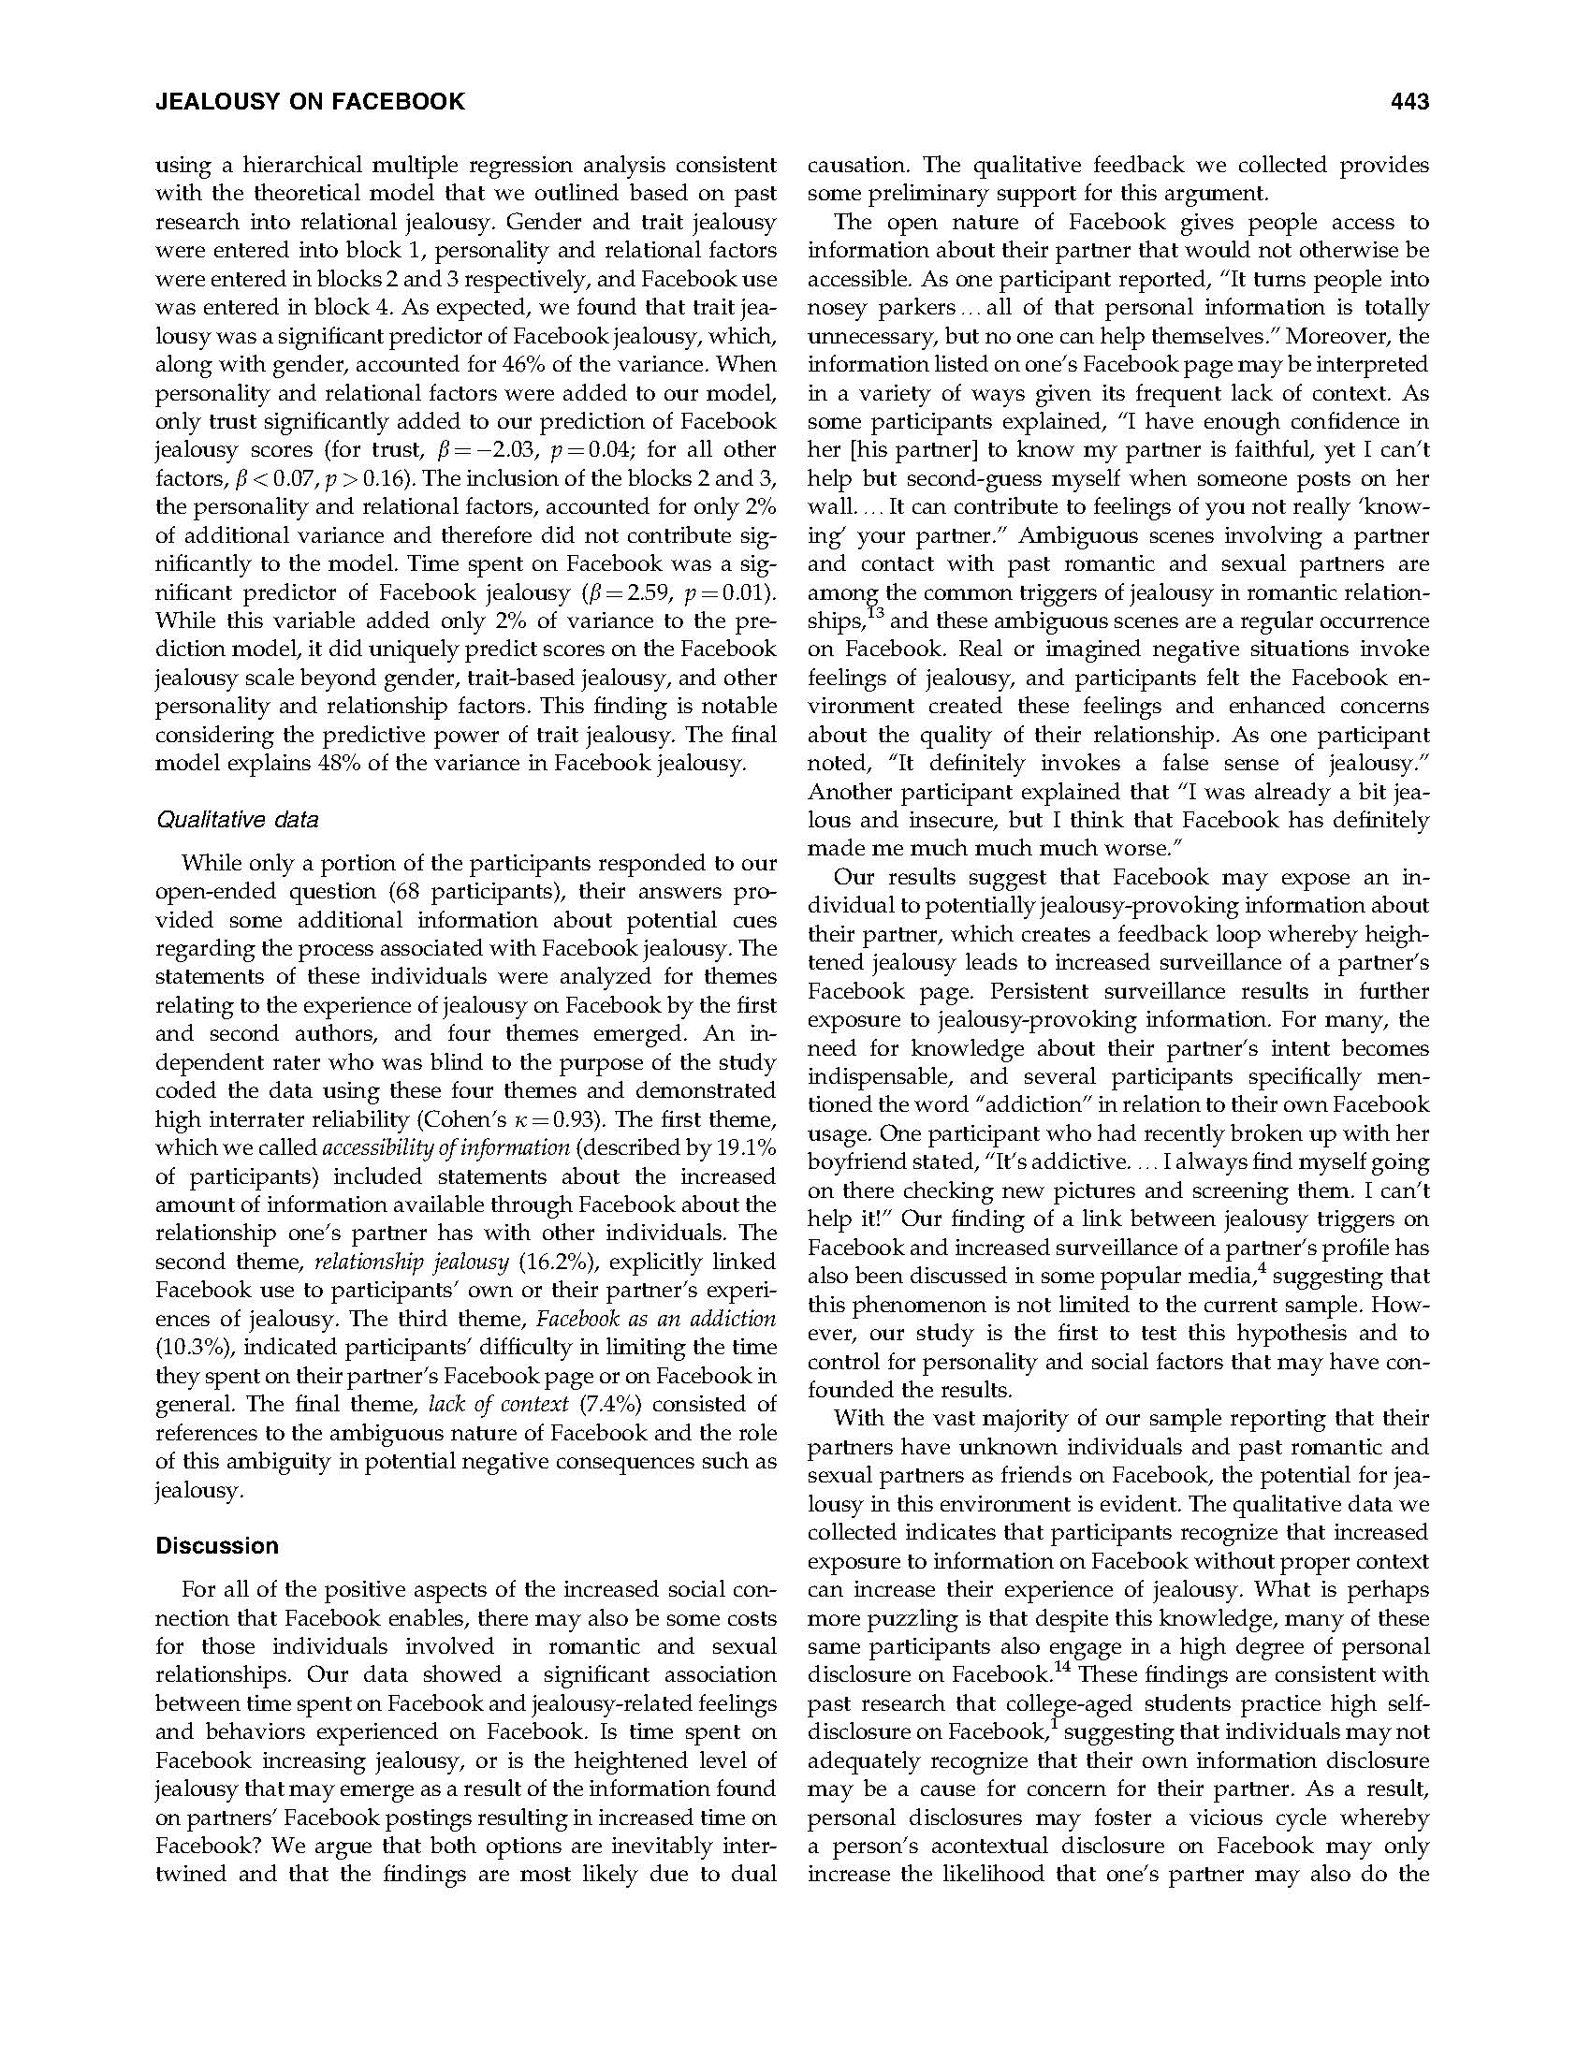
How to
Read a
Research Article
Psychology

Slide 2
How to complete
Click to highlight each section of the article one by one
Read the section, then click once to view the description of it
You can find the full article in the bottom left of this slide

Slide 3
Topics Covered
Abstract
Introduction/ Literature Review
Goal
Hypothesis
Headings and subheadings
Methods
Discussion
References

Slide 4
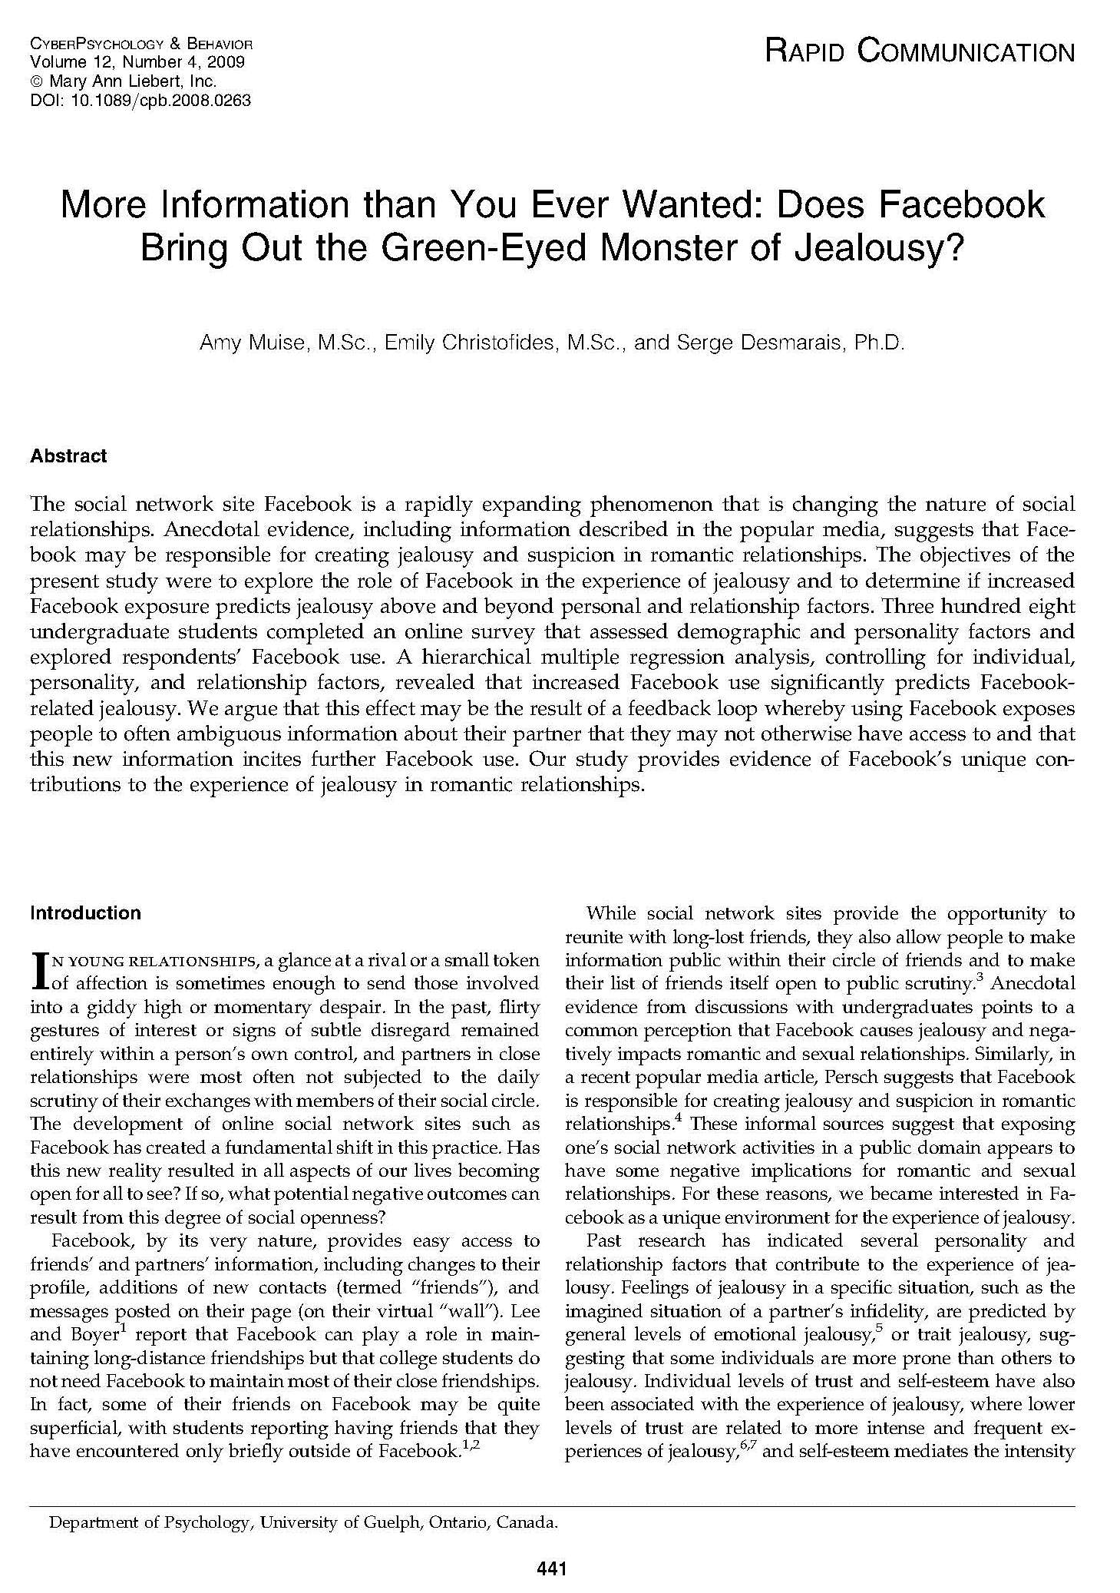
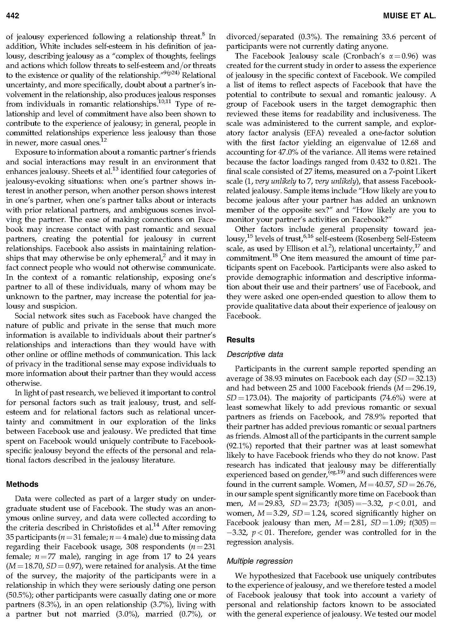
Brief synopsis of the study
Information about problem investigated, how investigated, the goal of the study, major findings, and hints at what the results could mean (e.g., implications of the findings).
Translation of their hypotheses into a set of specific, testable questions
Describes the research design: study participants, materials (questionnaires or special equipment), how the study was conducted
Purpose = the ability for other researchers to recreate the study to confirm (or question) its results
Describes how the data were collected and analyzed to determine whether the hypotheses were supported
Sometimes, the results are analyzed using qualitative analyses instead of quantitative statistics
Presents problem and states why it was important to study
Provides brief review of past research and theory leading up to the hypothesis (e.g., the literature review).
Describes how the study advances knowledge of the problem
Describes the hypothesis and how they decided on research strategy
A hypothesis is a prediction about the specific outcome the researchers expect to see, based on a theory and/or the literature review
Tip:
To find a hypothesis, look for certain keywords like “predict”, “investigate” or “demonstrate”
The results section can be a little intimidating, but as you can see, sometimes there are subheadings that give you a clue as to what you are reading.

Slide 5
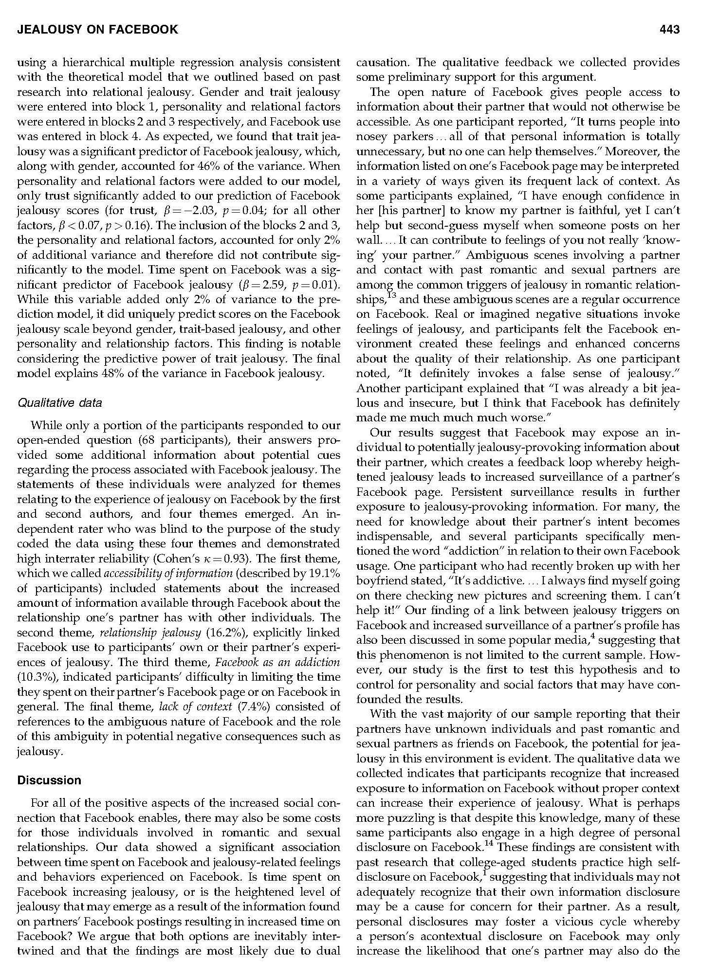
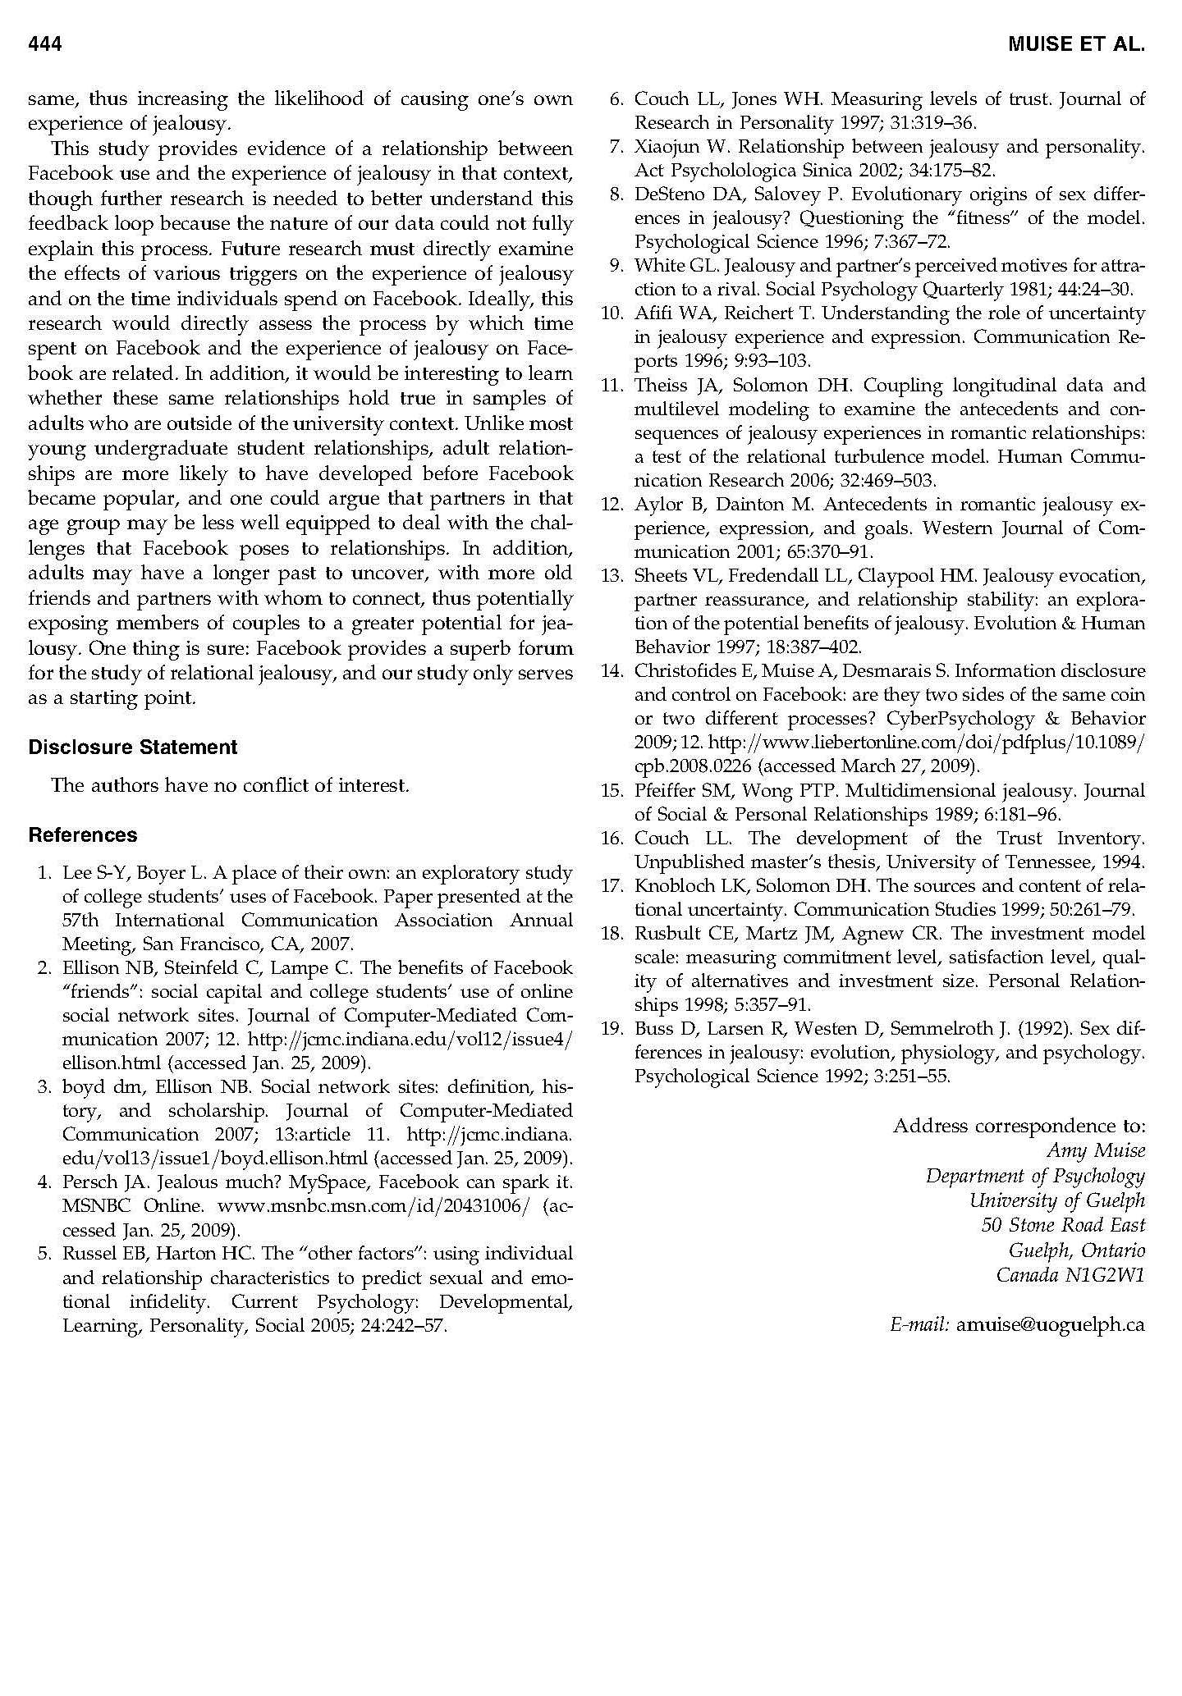
Results (continued)
Tip:
Some find it useful to read first few paragraphs of discussion before reading the full article to help guide their reading to focus on specific details needed for a complete understanding of the study
Tells which resources the authors consulted to inform their study
Tip:
A great list for finding other articles that may contain more information on the same topic
Summary of what the researchers found in words, without using numbers or statistical language, and if it supports the original hypothesis
Evaluates what the findings mean (e.g., implications of the study) and relates these results back to the research described in the Introduction
Includes sections on limitations (e.g., potential problems with the study), conclusions and implications (e.g., what’s the bottom line? What does it all mean?)
Suggests further research to overcome limitations

Slide 6
Questions?
ASK A
LIBRARIAN!!
http://www.ethomsen.com/wp-content/uploads/2011/06/5821099793_5590c99286_z.jpg

